Slide 1
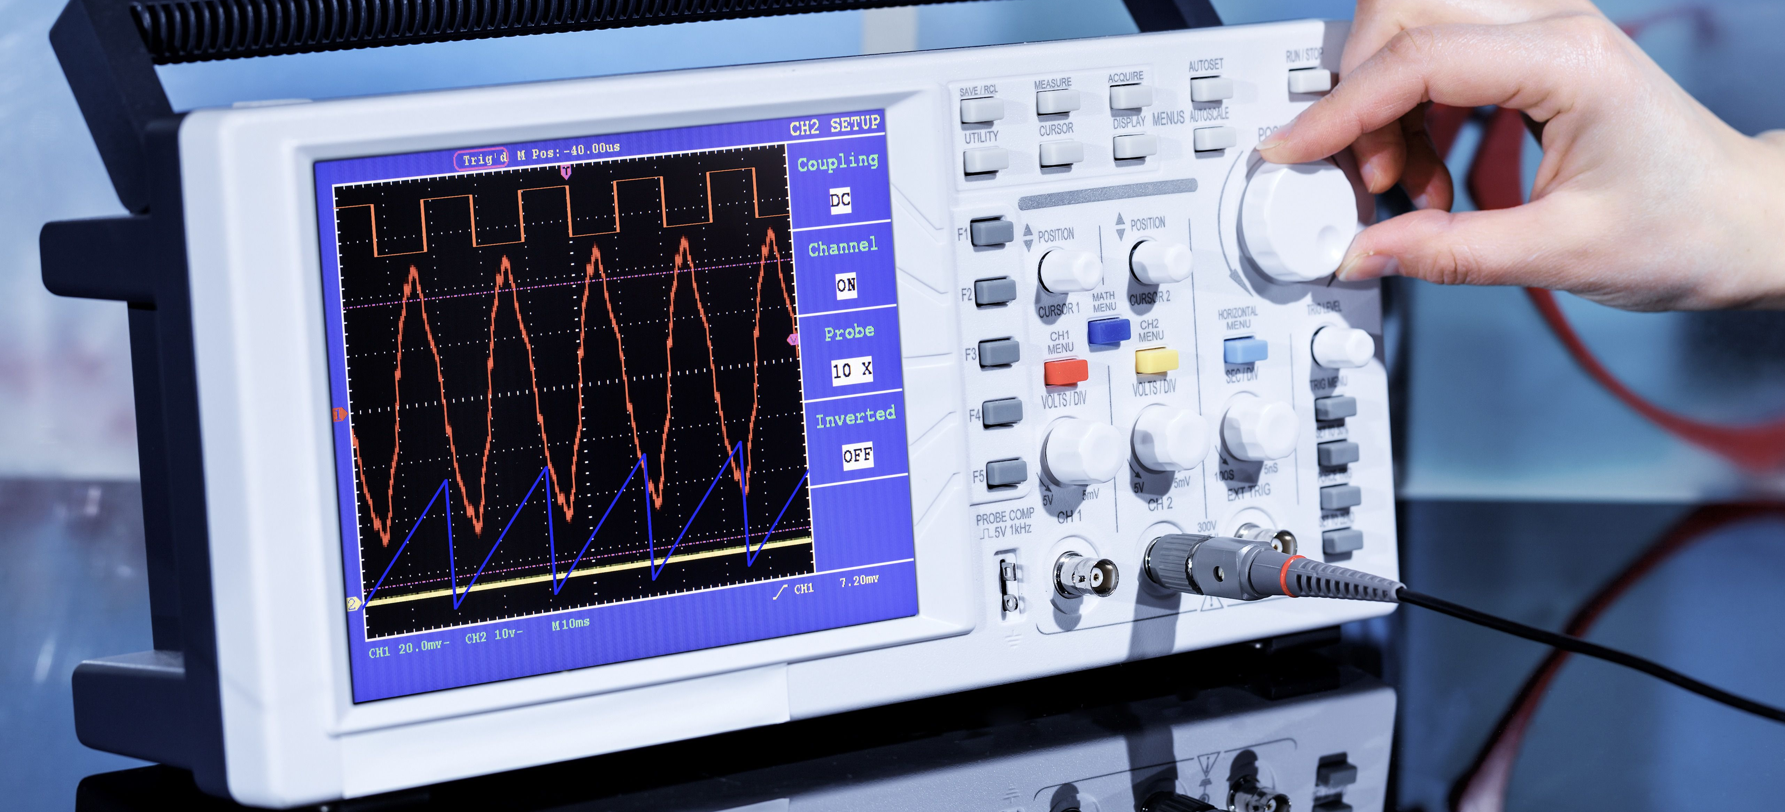
Oscilloscope Verification of PWM on Raspberry Pi
By :- Bilal Hussain & Nikunj Patel

Slide 2
Objective
The main purpose of this assignment is to test the PWM functionality on the RPi in the lab with the oscilloscope.
Testing the duty cycle at 75% and 90%.

Slide 3
PWM Testing
Used GPIO18 (Pin 12) for PWM output
Tested duty cycle at 75% and 90%
Verified waveforms on oscilloscope
LED provided visual confirmation of brightness change

Slide 4
Keyboard Inputs
a → LED on time 25%.
s → LED on time 50%.
d → LED on time 75%.
w → LED on time 90%.

Slide 5
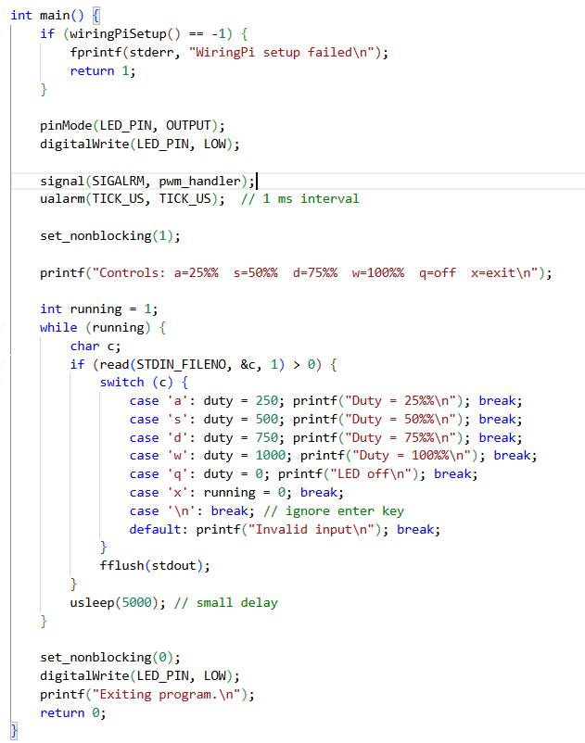
Code

Slide 6
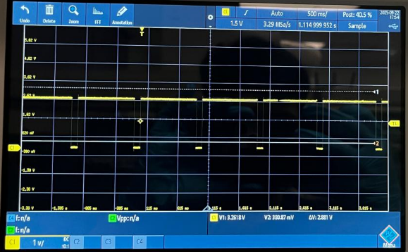
Oscilloscope readings at 90%

Slide 7
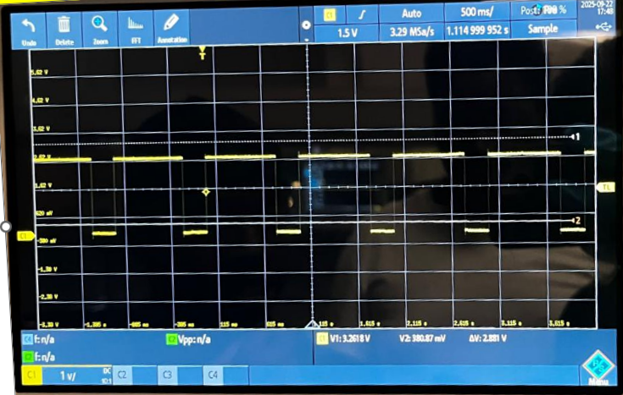
Oscilloscope readings at 75%

Slide 8

Results
PWM signals observed at 75% and 90% duty cycles
Oscilloscope confirmed correct waveforms
LED brightness matched duty cycle

Slide 9
Conclusion
Demonstrated PWM generation on Raspberry Pi.
Verified with oscilloscope.
Learned about PWM duty cycle, frequency, and safe GPIO usage.

Slide 10
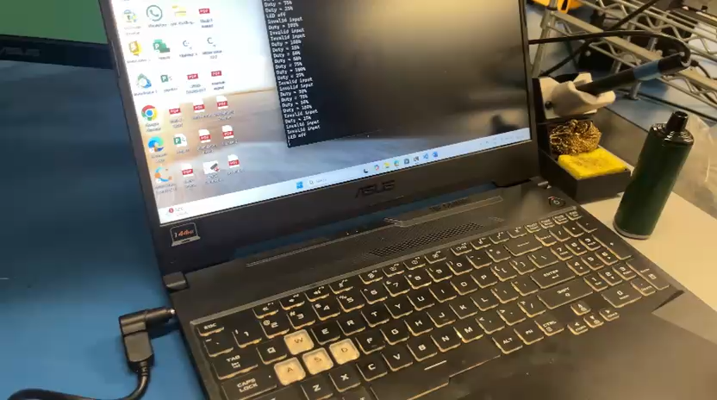
Testing Video

Slide 11

Thank You! Git: Bilal2866/ENGG-PROJECT-3

